Slide 1
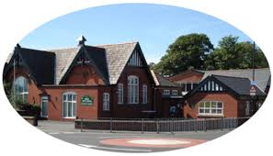
Ribby with Wrea Endowed C of E Primary
Welcome

Slide 2
Our Vision
We understand the uniqueness of all our pupils and encourage them to fulfil their potential . God is at the heart of our loving, inclusive family. We want all who learn and work here and within our community to experience the joy and hope of
“ Life in all its fullness” (John 10:10)

Slide 3
Mission Statement
To encourage all children to develop as confident lifelong learners, to be curious about the world around them and to achieve their full potential within our safe and caring Christian school family.

Slide 4
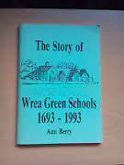
History of our school
We are very proud of the history of our school. The first school was built in 1693 with money left specifically for this by the village tailor who had gone to London and made his fortune.
Further villagers left money in their wills and consequently the present school was built in 1893.
Originally just the buildings which can be viewed from Dubside and then over the years the school has grown and developed to the school you are in today.

Slide 5
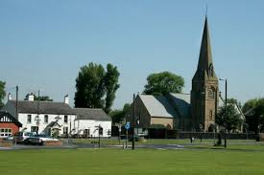
Church Links
We are very proud to be a distincitvely Christian school and have very strong links with St.Nicholas’ church Wrea Green.
- Weekly service
- JAM
-Sunday services
- Confirmation

Slide 6

Ofsted
We were inspected by Ofsted in November 2014.
We were rated as Outstanding in all areas.
We are very proud of this achievement.
We were inspected by SIAMs for our Church School Distinctiveness in November 2019 we were rated Excellent in all areas.

Slide 7
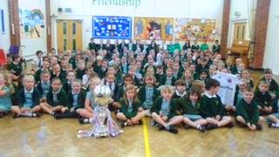
School Family
We strongly feel that when you choose Ribby with Wrea for your child you are joining our school family.

Slide 8
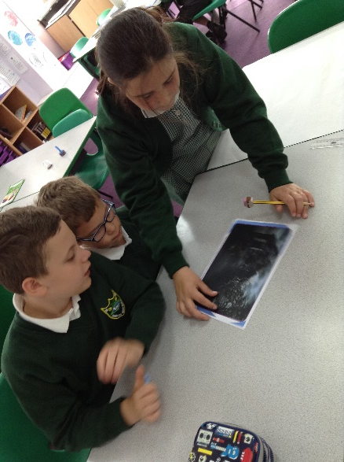
Learning across the curriculum
Every member of staff at our school has very high expectations both of behaviour and application to learning.
We offer a wide and varied curriculum that is planned with every child’s needs and interests in mind.
The children always find themselves engaged in exciting and vibrant learning that enables them to make rapid progress and achieve their very best.
All of our children are taught in mixed age classes.
PE
DT
Art
Science
History
Geography
Computing
PSHE
French
Music

Slide 9


Extra Curricular
We offer a wide variety of extra activities outside of the school day. Children can attend judo, football, tennis, basketball, jam coding and choir.
We have had a very successful year on the Sport front. We have achieved School Games Platinum mark for 4 years, one of only a handful of Fylde schools to do so.
Netball - mixed
Football - mixed
Tag Rugby – mixed
Basketball- mixed
Aqua Splash – mixed
Glo dodgeball- mixed
Hockey- mixed
Archery - mixed

Slide 10
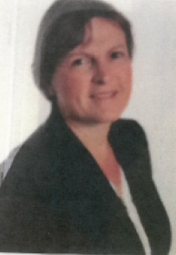
Governors, Trustees, PTFA
We have a very supportive Governing body who support the Headteacher in ensuring the school continually improves.
Gill Metherell is the Chair of Governors.
Our Trustees support the school and contribute to added extras for all pupils. Richard Millar is Chair of the Trustees
We have a lively PTFA who organise family fun events. Disco, dress up days, Santa’s Grotto.

Slide 11
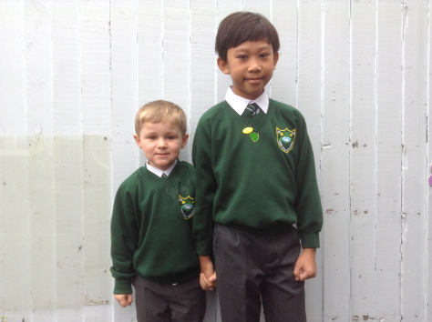
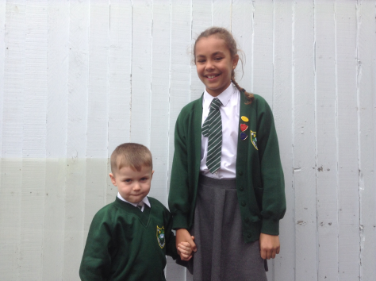
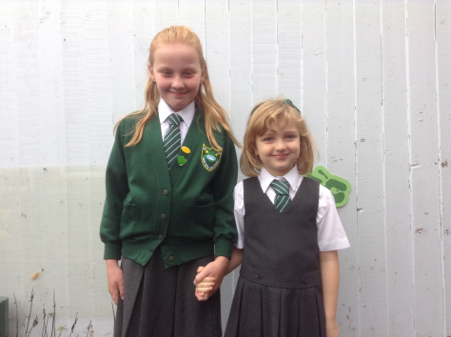
Safeguarding
The safety of all children in our care is our number one priority.
Your child will develop within a loving Christian environment where bullying and intolerance of any kind is not acceptable.
The children understand how to care for one another.

Slide 12
Technology
We believe that new technologies are essential for our pupils to develop in society.
All children have access to laptops and I pads.
We develop computer programming programmes such as Scratch.
We use See Saw as a Learning Platform.
We are a flagship school for innovation in Lancashire.

Slide 13

School Day
A typical day in Reception starts with the children coming gradually into school from 8.40am – 8.50am. They access a wide variety of activities on arrival. The class teacher will then register the pupils before they meet with the rest of school to enjoy an act of worship. They will then spend the morning totally immersed in Maths and English tasks and activities. Some teacher led, some independent. They have access to outdoor activities throughout the day. They have milk and fruit. They enjoy a morning and afternoon playtime in the playground. They enjoy a freshly cooked lunch in the hall, sitting in friendship groups. During the afternoon they will explore a wide variety of subjects. They will have 2 PE sessions a week, visit the school library, explore scientific, creative and imaginative learning before all going home at 3.15pm.

Slide 14
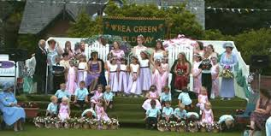
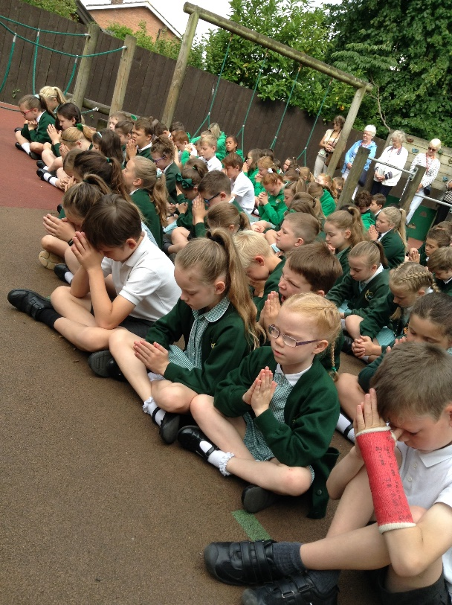
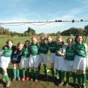
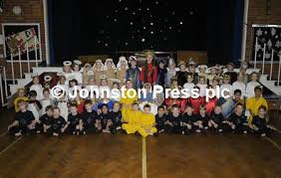
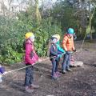
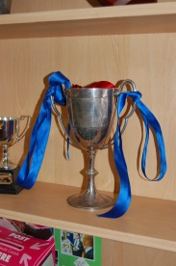
Houses
Ribby
Bryning
Wrea
Westby

Slide 15
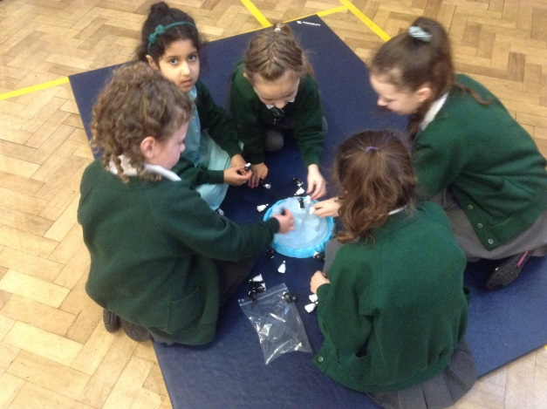
Before and After School Care
Breakfast Club
After School Club
Holiday Clubs
Our school website.
www.ribby.lancsngfl.ac.uk

Slide 16

Question Time

