Slide 1

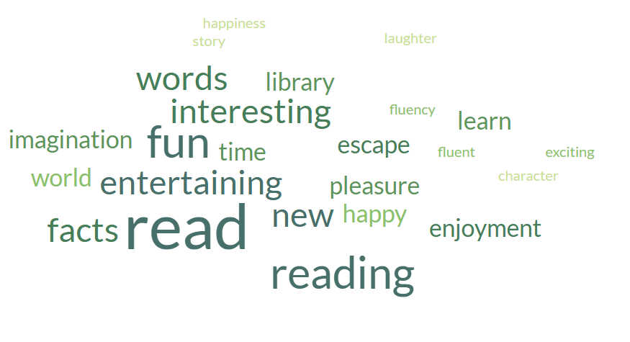
The Importance of
Reading

Slide 2
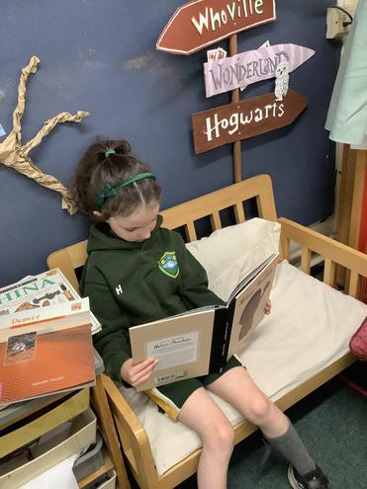
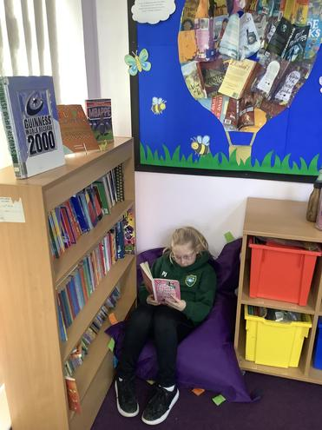
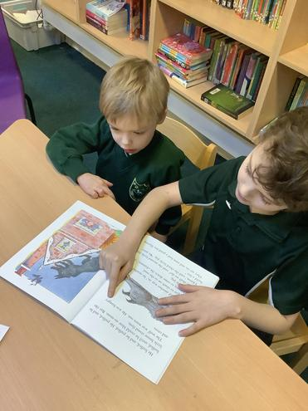
Reading in primary school is crucial because it builds foundational skills for academic success, broadens vocabulary, enhances concentration, boosts imagination, develops empathy, and improves overall cognitive and mental well-being. It allows children to understand the world, build relationships, and excel across the entire curriculum and in life.

Slide 3
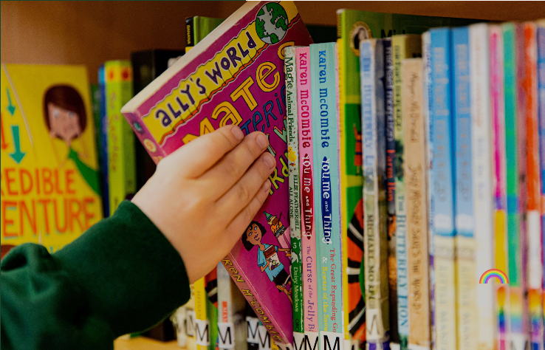
We aim to make the children at Ribby with Wrea enthusiastic, fluent and responsive readers who can learn and gain pleasure from the written text.
To develop our pupils as readers we:
Teach them to read accurately and fluently using a range of strategies.
Help them to understand and respond to what they read using inference and deduction where appropriate.
Encourage them to read a wide range of fiction and non-fiction books.
Encourage them to read independently and with enjoyment.
Teach them how to seek information and learn from the written word.

Slide 4
How to support your child?
It is important that your child reads their school reading books at least 3 times a week at home. These books are specifically chosen to meet your child's reading age and level of understanding.
Make reading part of your daily routine. Your child could read to you whilst you are making tea, just before they go to bed or as soon as they get in from school.
When listening to your child read it is important you talk about any new words your child does not know the meaning of and question their understanding through the book.

Slide 5

Questions…
Before your child reads a book, ask:
What makes you think this book is going to be interesting?
What do you think the book is going to be about?
What kind of characters do you think will be in the book?
What do you think is going to happen?
While your child is reading a book, try asking:
What’s happened so far?
What do you think will happen next?
If you were that character, what would you have done differently in that situation?
What have you learnt about the characters?
Where is the book set?
Did you learn any new words or facts so far?
After your child has finished a book, ask questions like:
What was your favourite part of the book? Why?
Who was your favourite character? Why?
What was the most interesting thing you learned from the book?
Would you have ended the book differently? Did it end the way you thought it would?
Did the problem of the book’s plot get solved?

Slide 6

Some Reading Strategies
Turn taking – read a page each.
Look for key words/ tricky words.
Try reading the story together.
Pick your time wisely! What works best for you and your child?
Why not retell the story in your own words?
Encourage your child to change books regularly.
Make it manageable in terms of how much you read. Try reading little and often.

Slide 7

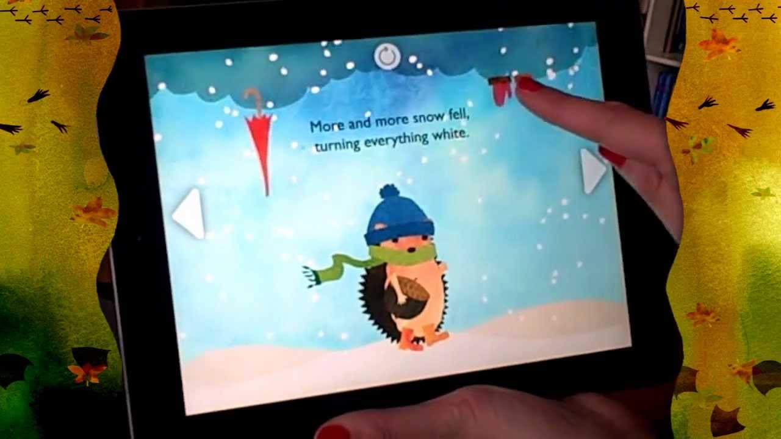

“But do I have to read now?”
We know it can sometimes be a battle to get your children to read. There are lots of different ways you can engage your children, here are some ideas below.
Join the library
Build a home library
Let your child choose the book
Use funny voices!
Tap into their interests
Take books with you on journeys or shopping trips
Use technology to your advantage
Variety! Let them read magazines, leaflets, booklets, cook books, instructions…

Slide 8
Our Expectations.
You must remember that getting through our reading scheme is not a race. Each child moves through the school reading scheme at their own pace and when their comprehension skills have developed.
Reception/ Year 1
We expect your child to read at least 3 times a week at home, however it will greatly improve your child's fluency and vocabulary if they read every night. Re-reading the same text and questioning your child will help develop their comprehension skills and understanding, enabling them to transfer these skills into the classroom.
Year 2 – Year 6
We expect your child to read for 15-20 minutes at least 3 times a week at home. It is important that they read the books sent home from school as this will help develop their vocabulary and comprehension skills. In addition, children are encouraged to read for pleasure any other books they find interesting. These can be recorded in your child's reading record.
Books can be changed twice a week in school. We encourage the children to have their reading books in school every day as they may be asked to read with a member of staff.

Slide 9
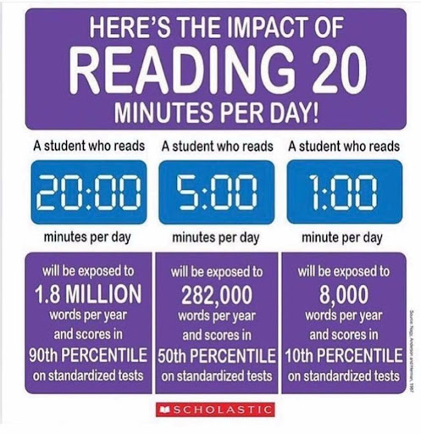
Did you know?

